Slide 1

Infrastructure as a Service and Microsoft Azure Stack Hub
Compute in Microsoft Azure Stack Hub
This work is licensed under a Creative Commons Attribution - ShareAlike 4.0 International Public License

Slide 2
Agenda
Overview
IaaS, Solution Overview and ARM
Azure Stack Hub Compute
Compute, VMs, Gaps, Managed Disks, Fault Domains
Operator Scenarios
Infrastructure VMs, Quotas, Extensions
Compute Controller

Slide 3
Overview

Slide 4
Azure Stack Hub IaaS – Why should you care?
Infrastructure as a Service
VMs, Disks, NICs, Networks
VMs (IaaS) are the first step
Touch stone for Azure consistency
Almost every app requires an IaaS infrastructure
Middleware, SQL Server, Exchange Server
All Platform as a Service (PaaS) offerings build off IaaS
SQL Server, Service Fabric, Notification Hubs, API apps, web apps, etc.
Azure Stack Hub is designed for Hybrid workloads

Slide 5
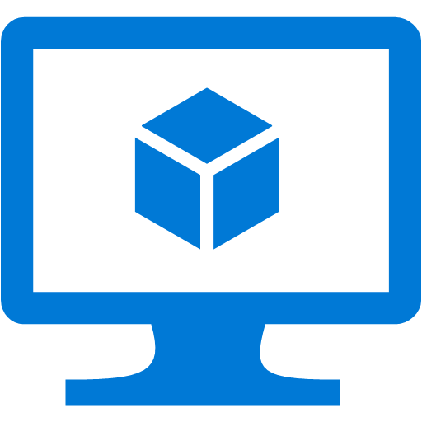
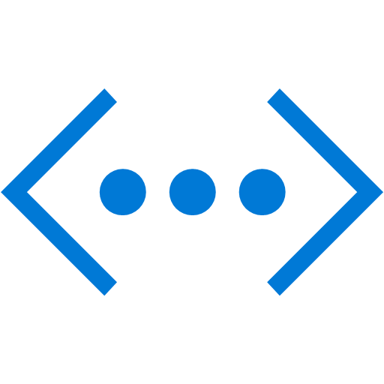
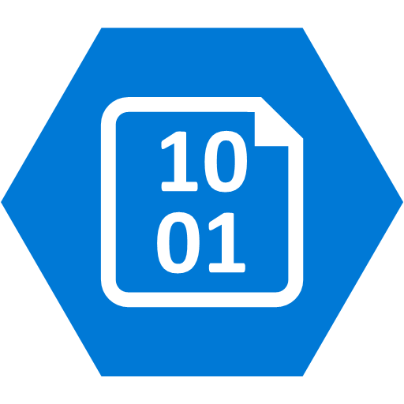

Solution view
Guest Workload Resources
(IaaS + PaaS)
Storage Blobs
Websites
(.NET, PHP, Python … )
Virtual Machines
(Linux or Windows)
Virtual Networks
Service Fabric Clusters
End User Experiences
Azure Portal | Developer Tools (MSFT & Open Source)
Azure Resource Model
Azure Resource Manager
Microsoft Azure Services
Core Services
Identity | Subscriptions | RBAC | Gallery | Metrics | Usage
Azure | Azure Stack Hub
Extensible Service Framework
Additional Services
3rd Party Services
Foundational Services
Compute | Storage | Networking | Key Vault
Cloud Infrastructure
Infrastructure Management
Compute
Storage
Networking

Slide 6
Guest Workload Resources
(IaaS + PaaS)
Storage Blobs
Websites
(.NET, PHP, Python … )
Virtual Machines
(Linux or Windows)
Virtual Networks
Service Fabric Clusters
End User Experiences
Azure Portal | Developer Tools (MSFT & Open Source)
Azure Resource Model
Azure Resource Manager
Core Services
Identity | Subscriptions | RBAC | Gallery | Metrics | Usage
Azure | Azure Stack Hub
Additional Services
Azure Stack Hub can be extended here – keeping pace with extensions added in Azure...
Extensible Service Framework
}
Foundational Services
Compute | Storage | Networking
Cloud Infrastructure
Infrastructure Management
Compute
Storage
Networking

Slide 7
ARM and Resource Providers
Azure Resource Manager (ARM)
Provides Azure-consistent management across public and private cloud infrastructures
Clients can use REST, PowerShell/CLI or the Portal
Resource Providers (RP) manage a type of infrastructure
Compute Resource Provider (CRP)
Network Resource Provider (NRP)
Storage Resource Provider (SRP)
Express desired state
Template = declarative statement
ARM → necessary orchestration + imperative directives to RPs
Describe
Deploy
Control
Gallery
Azure Resource Manager
Azure Resource Manager
Consistency
MICROSOFT Azure Stack Hub
MICROSOFT AZURE

Slide 8
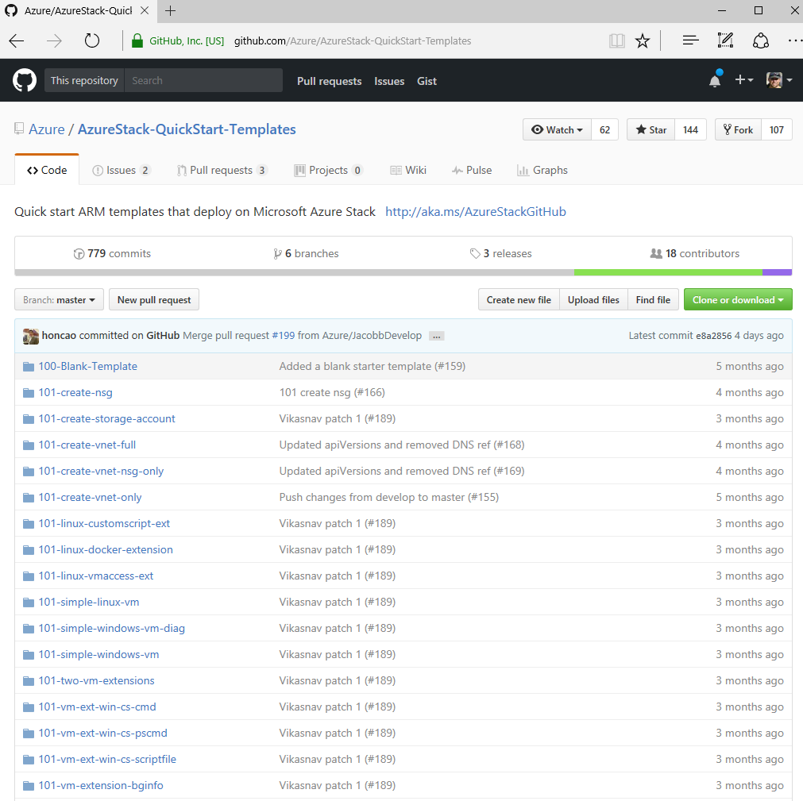
IaaS workload scenarios
Azure Stack Hub enables a number of IaaS workloads:
Quick start templates work on Azure and Azure Stack Hub
https://github.com/Azure/azurestack-quickstart-templates
SQL Server 2014 web – gallery and template
SQL Server 2016 developer – gallery
SharePoint 2016 – template
Mesos – template
Docker swarm – template
Remote Desktop Services 2012 R2 and 2016
Ethereum Blockchain
Docker Swarm

Slide 9


ARM and Resource Providers
virtualMachine
hardwareProfile
osProfile
storageProfile
networkProfile
storageAccount
accountType
Resource Group
virtualNetwork
addressSpace
Subnet
addressPrefix
Subnet
VM
networkInterface
privateIPAllocationMethod
NIC
publicIPAddress
allocationMethod
domainNameLabel
Public IP
Storage
VNet
ARM templates specify all resources needed to make up a solution and can include one or more VMs
https://github.com/Azure/AzureStack-QuickStart-Templates/tree/master/101-simple-windows-vm

Slide 10
Azure Stack Hub Compute

Slide 11
Compute services in Azure Stack Hub
Support for Windows and Linux VMs
Can be from custom or syndicated images
Subset of Azure sizes
(A, Av2, D, Dv2, DS, DSv2, F, Fs and Fsv2)
Performance depends on the underlaying infrastructure
VM Scale Sets (VMSS)
VMSS Gallery item built-in
Currently no insights-based auto scale
Entry level
A
Av2
General Purpose
D
Dv2
DS
DSv2
Compute Intensive
F
Fs
Fsv2

Slide 12
Compute performance in Azure Stack Hub
Emulation is imperfect and is focused on uniform in-guest quantities
RAM, CPU, Disk size quantities are aligned to Azure
CPU performance is better than Azure for low-load environments
CPU performance is non-deterministic for a given VM size
Storage performance is likely to be significantly better than Azure
For networking egress from the VM, there are bandwidth caps in place. Caps in Azure Stack Hub are the same as the caps in Azure.
Entry level
A
Av2
General Purpose
D
Dv2
DS
DSv2
Compute Intensive
F
Fs
Fsv2

Slide 13
GPU Compute in Azure Stack Hub
AI, Machine Learning (ML), VDI and Inferencing
Three GPU models and associated VM sizes
NCv3 = NVIDIA V100 Tensor Core GPU
Learning, inference, and visualization scenarios.
NVv4 = AMD Mi25
Partitioned GPU VM sizes useful for visualization scenarios
NCasT4_v3 = NVIDIA T4 Tensor Core GPU
light learning, inference, and visualization scenarios
GPU Compute
NCv3
NVv4
NCasT4_v3

Slide 14
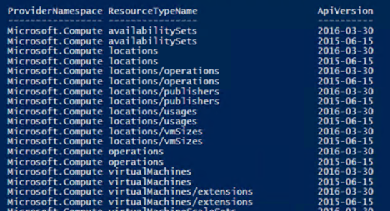
Compute API gaps
Current state
Subset of API versions
No Encrypted Disks
No autoscale support
No host-based diagnostics except VM CPU percentage
PowerShell Example
Get-AzureRmResourceProvider | `
Select ProviderNamespace -Expand ResourceTypes | `
Select * -Expand ApiVersions | `
Select ProviderNamespace, ResourceTypeName, @{Name="ApiVersion"; Expression={$_}} | `
where-Object {$_.ProviderNamespace -like “Microsoft.compute”}

Slide 15
VM lifecycle gaps
Redeploy VMs is only possible on multi-node systems
Guest diagnostics is Windows-only
Disks are fixed-size and cannot exceed the total storage on the system
Azure Instance Metadata Service isn't supported
Considerations for using virtual machines in Azure Stack Hub https://docs.microsoft.com/en-us/azure/azure-stack/user/azure-stack-vm-considerations

Slide 16
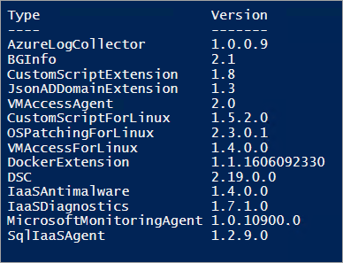
Virtual machine extensions
Azure Stack Hub supports a subset of virtual machine extensions and versions.
The cloud administrator can choose which extensions to be made available to for their users.
PowerShell Example
Get-AzureRmVmImagePublisher -Location local | `
Get-AzureRmVMExtensionImageType | `
Get-AzureRmVMExtensionImage | `
Select Type, Version | `
Format-Table -Property * -AutoSize

Slide 17
Deploying VMs on Azure Stack Hub:
The same experience as Azure
Use GitHub Azure Stack Hub QuickStart templates to deploy workloads
Note: Choose GitHub Templates that are noted as applicable for Azure Stack Hub
Leverage PowerShell
Note: Az PowerShell module is now the recommended PowerShell module
Please visit for details: https://docs.microsoft.com/en-us/azure-stack/operator/powershell-install-az-module
Leverage Visual Studio to deploy workloads to Azure Stack Hub
Note: Visual Studio Community 2015 with Microsoft Azure SDK - 2.9.6
Please visit for details: https://docs.microsoft.com/en-us/azure-stack/user/azure-stack-install-visual-studio

Slide 18
Managed disks overview
Hides complexity of storage accounts and scale limits
Simpler management for customers
Better performance
Storage account limits (in Azure) do not apply
Granular access control
Top level ARM resource – You can apply Azure RBAC, Locks, and Tags at the disk-level
Smarter about availability sets
Different fault domains – Disks in different Storage clusters (in Azure)
Easy migration from standard to premium (in Azure)
Minimal downtime with background migrations – not available in AzS yet
Azure Stack Hub Managed Disks: Differences and considerations https://docs.microsoft.com/en-us/azure/azure-stack/user/azure-stack-managed-disk-considerations

Slide 19
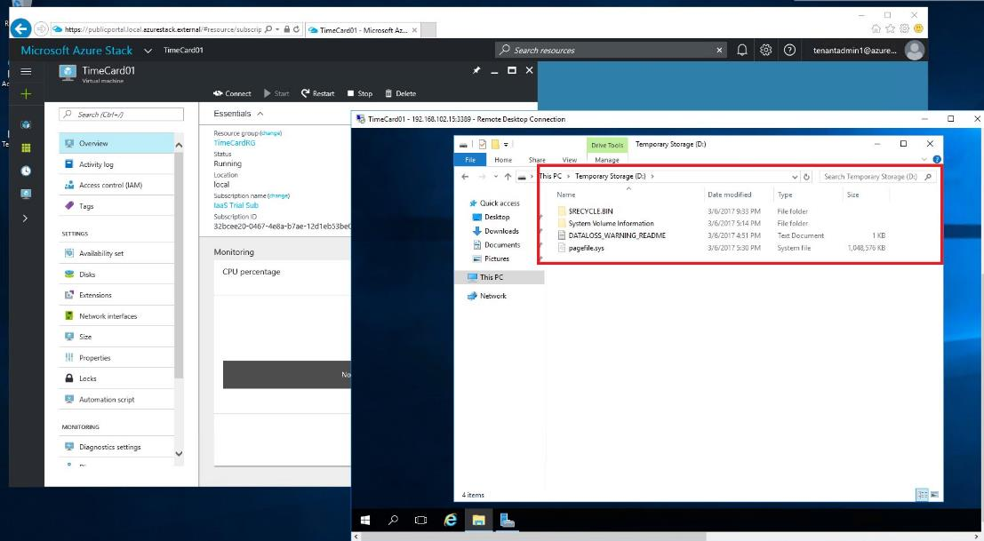
Temporary disks on Azure Stack Hub
Temp Disks (local disks) are now emulated as part of the VM size (D:\ drive)
Temp disks are dynamic VHDs as opposed to the fixed disks used for OS and Data Disks
Allows Azure Stack Hub to run workloads where storage resilience is provided at the application layer as opposed to in the infrastructure
The Pagefile is stored here for Windows VMs as it is in Azure virtual machines

Slide 20
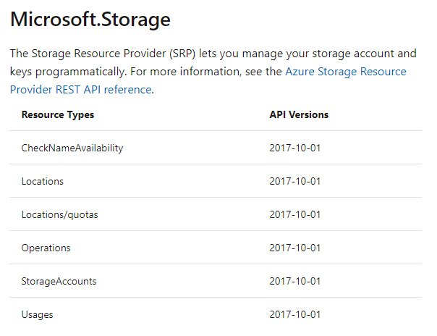
Storage gaps
Storage API versions
Not all API versions available
Azure Files
No support for Azure Files
Premium Storage
Premium Storage only for API consistency
Up to 2300 IOPs or 145 MB/s throughput per disk
No SLA / performance guarantee

Slide 21
Fault domains on Azure Stack Hub
Every host is ‘colored’ to match a fault domain for a particular availability set
A 4-node system can handle an availability set with 3 fault domains (with 1 node held in reserve for use during patch and update activities)
Host #1
Host #2
Fault Domain 1
Fault Domain 2
Host #3
Host #4
Reserve
Fault Domain 3

Slide 22
Example – Fault domains on Azure Stack Hub
Availability Set #1 – 3 VMs with a spread of 3
Availability Set #2 – 4 VMs with a spread of 2
VM 2
FD 2
VM 1
FD 1
Host #2
Host #1
VM 4
FD 2
VM 2
FD 2
VM 3
FD 3
VM 3
FD 1
Host #3
Host #4
VM 1
FD 1

Slide 23
Availability Set Template examples
{
"$schema": "https://schema.management.azure.com/schemas/2015-01-01/deploymentTemplate.json#",
"contentVersion": "1.0.0.0",
"parameters": { }
"resources": [
{
"type": "Microsoft.Compute/availabilitySets",
"name": "availabilitySet1",
"apiVersion": "2015-06-15",
"location": "[resourceGroup().location]",
"properties": {
"platformFaultDomainCount": "3",
"platformUpdateDomainCount": “3"
}
}
]
}
{
"$schema": "https://schema.management.azure.com/schemas/2015-01-01/deploymentTemplate.json#",
"contentVersion": "1.0.0.0",
"parameters": { }
"resources": [
{
"type": "Microsoft.Compute/availabilitySets",
"name": "availabilitySet1",
"apiVersion": "2015-06-15",
"location": "[resourceGroup().location]",
"properties": {
"platformFaultDomainCount": “5",
"platformUpdateDomainCount": “3"
}
}
]
}
A 4-Node Azure Stack Hub Scale Unit cannot support 5 fault domains…

Slide 24
Operator Scenarios

Slide 25
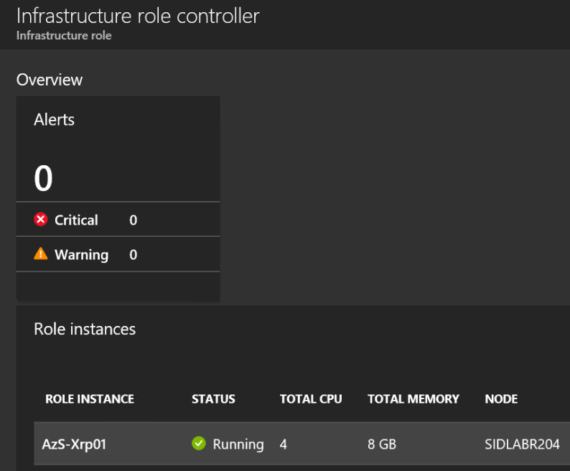
Infrastructure VM lifecycle on Azure Stack Hub
During deployment, infrastructure VMs are registered to the Compute Controller (CRP)
Infrastructure VMs are created as Gen 2 with dynamic memory - Tenant VMs as Gen 1
The CRP is responsible for the lifecycle of these virtual machines
A particular infrastructure VM in the Portal is an ‘infrastructure role instance’
These VMs can be started, restarted or shut down through portal or PowerShell
CRP uses placement rules to prevent all the infrastructure VMs of the same type from running on the same host

Slide 26
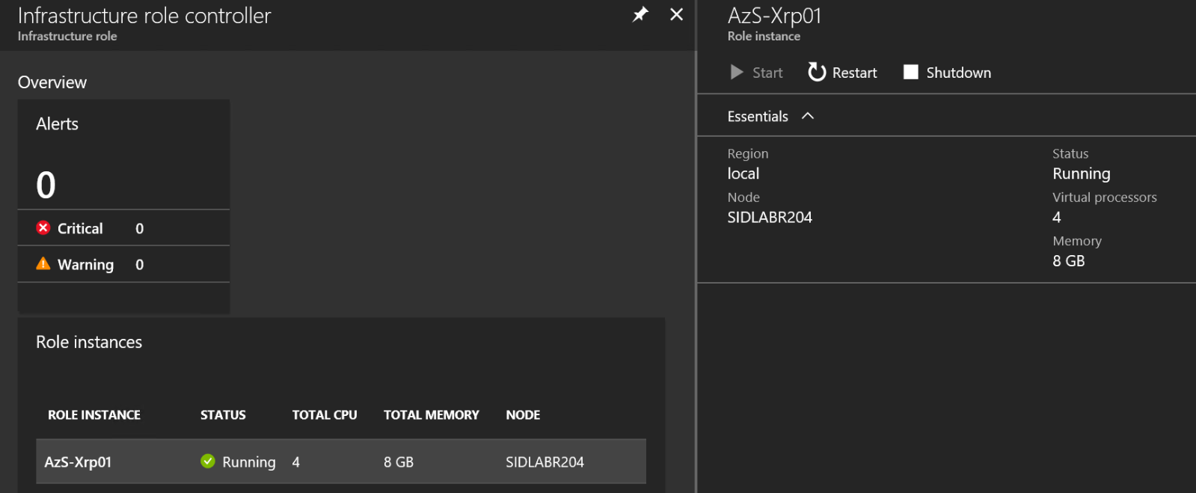
Infrastructure VM lifecycle on Azure Stack Hub
These lifecycle operations are conducted by Compute Controller
Possibly inaccessible when Compute Controller is unable to be accessed

Slide 27
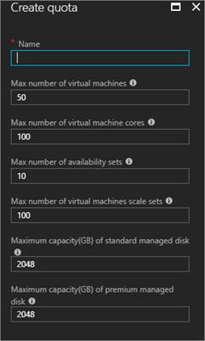
Compute capacity management
Workloads are memory bound
Warning at 85%
Critical at 95%
VMs can fail to deploy or start if memory is exhausted
Memory is consumed by both infrastructure and tenant VMs
Tenant VMs can have more total vCPUs than there are physical CPUs
Capacity is only added by adding a new node
Core count is not factored against capacity
Quota Management
Tenants can be given quotas on cores, number of VMs, availability sets, VM scale sets, standard managed disk and premium managed disk sizes

Slide 28
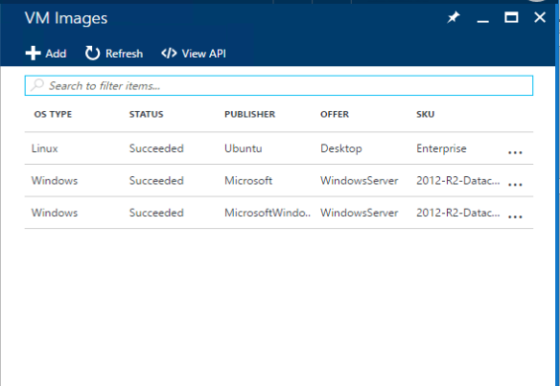
Marketplace - Third-party workloads
Image syndication
Curated Windows and Linux images for admins
Requires registration
Images are large (30GB – 127GB). Watch your disk space!
Extension syndication
Curated 1st and 3rd party extensions from Azure
Not all extensions are available
Sideloaded images
Administrators can add custom Windows or Linux images
Linux images require walinuxagent v2.2.22

Slide 29
Compute Controller

Slide 30
Compute Resource Provider architecture
Azure Resource Manager (ARM)
Microservices Architecture
Resiliency provided by running all services in a Service Fabric ring
Virtual Machines
Quota
Computer Resource Provider Tenant Resources
Computer Resource Provider Admin Resources
Add VM Images for tenant consumption
VM Extensions
Born from Azure Compute
Leverages code hardened in Azure
Compute Microservices
Content Microservices
Storage RP
Blob Manager
Manifest Provider
Diagnostics Manager
Extension Manager
Platform Image Repository
Guest Metadata Server
Guest Artifact Repository
Network RP
Network Manager
ISO Manager
Compute Controller
New infrastructure component manages compute clusters and orchestrates virtual machine creation
Fabric Layer
Topology Manager
Cluster Manager
Availability Set Controller
Clustered
Compute Controller
Virtual Machine Orchestrator
Cluster
Orchestrator
Data Service
Hypervisor

Slide 31

Creating a virtual machine
Creation Pipeline
The Compute Resource Provider’s (CRP) virtual machine pipeline is a goal seeking engine that exercises the full breadth of core services in Azure Stack Hub to create and place VMs
Tenant VM Request
Template Validation
Build VM Placeholder
CRP tenants can bring their own images or leverage images added to the CRP’s VM Image repository
Select Cluster and Host
Compute Controller
Acquire Page Blob
Storage RP
Create NIC
Network RP
Allows an Azure Stack Hub administrator to track consumption of the CRP’s services and gain insights into tenant usage patterns
Register for Usage
Start and customize VM

Slide 32
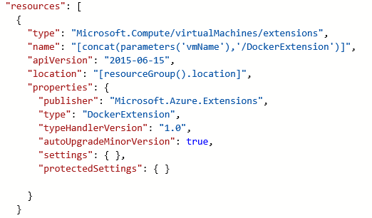

Deploying VM extensions
Extensions allow in-guest customization of a new or existing VM
Extensions are deployed using the Azure Linux and Windows agents
The Azure Linux Agent is preloaded into Linux VM Images, and the latest version is required for use with Azure Stack Hub
Extension Manager
Guest Metadata Server
Host Plugin
Check VM extension repository
Tenant
VM
Guest Agent
Extension Deployment Request

Slide 33


Curating compute content for your Azure Stack Hub
CRP will expose ARM-based administrative UI and APIs to facilitate access to the VM image and extension repositories
This will enable making specialized images available, like “Contoso’s golden image” to your Azure Stack Hub tenants
This is the core functionality that is used to deliver Marketplace syndication
Sample Azure Stack Hub VM images:
Sample Azure Stack Hub VM extensions:
Ubuntu 16.04 and above
Windows Server 2016
VMAccessAgent
VMAccessForLinux
DockerExtension
Desired State Configuration (DSC)
CustomScriptExtension (Windows)
CustomScriptExtension (Linux)
BGInfo

Slide 34
Azure Stack Hub architecture overview
ARM LAYER
Azure Portal (UX)
Templates/PowerShell/CLI, SDK, etc
Azure Resource Manager (ARM)
RP LAYER
PARTITION REQUEST BROKER
FRP
SRP
CRP
NRP
HRP
URP
…
INFRASTRUCTURE CONTROL LAYER
Infrastructure Deployment
Bootstrap
PHYSICAL
NODE
MANAGEMENT
STORAGE CONTROLLER
COMPUTE CONTROLLER
NETWORK CONTROLLER
INFRA ROLE CONTROLLER
HEALTH CONTROLLER
Patch & Update
INFRASTRUCTURE ROLES
Scale Out
Workflows
ACS
NETWORK CONTROLLER
COMPUTE CONTROLLER
HEALTH CONTROLLER
INFRA ROLE CONTROLLER
ARM
UPDATE MGMT
DIRECTORY MGMT
FRU
RESET
STORAGE CONTROLLER
EDGE GATEWAY
INFRA MGMT
CONTROLLER
PARTITION
REQ BROKER
ADFS
Builds
START
LB MUX
PHYSICAL NODE MGMT
INTERNAL DATA STORE
CERTIFICATE MGMT
STOP
INFRA DEPLOYMENT
HARDWARE LAYER
NETWORK (SWITCHES)
COMPUTE
STORAGE

Slide 35
Clustering and Compute Controller
CRP
Compute Controller uses Windows Server compute features
COMPUTE CONTROLLER
Failover Clustering
Hyper-V

Slide 36
Cluster/server compute lifecycle
The Scale Unit (Cluster) and its nodes are registered against Compute Controller during deployment
Compute Controller executes the drain of nodes for field replacement unit (FRU) scenarios
Compute Controller orchestrates the power cycle of Scale Unit nodes
VM clustering gives High Availability. The movement of VMs maintains high availability even during server-down conditions like patch-and-update cycles
Node 2
Node 1

Slide 37
Questions?

Slide 39
Appendix

Slide 40
Common Issues

Slide 41
VM/VM scale set fails to deploy
Misspelled or nonexistent platform image
Add the correct platform image
Host does not have enough resources left
Add Scale Unit or remove VMs
Agent failed to communicate provisioning status
Get agent logs from guest VM or redeploy
Can’t communicate with storage and network service
Restart infrastructure roles, or check resources usage on the XRP cluster
Used wrong disk type (Managed vs. Blob)
Redeploy using the correct disk type

Slide 42
VM extension fails to deploy
Wrong extension version or autoupgrade is false
Set autoUpgradeMinorVersion to true or syndicate correct extension version
Extension script hangs or fail
Analyze guest agent logs for script output
Gateway unable to forward extension package
Restart the Gateway roles
Extension is using wrong storage endpoint
Check template that calls the extension
Azure Stack Hub only supports one DSC configuration currently
Multiple DSC configurations will cause failures

Slide 43
Failed to add VM image
Download script or token timed out
Fixes coming for this issue. Delete the image from the UI and retry
Failed with no additional information
Delete the image from the UI
Make sure that the image and folder are deleted from the PIR on the infrastructure share
Incorrect OS type specified
Remove the VM image and add it again

Slide 44
VM lifecycle operations
VM fails to restart/start/shut down (power state)
Validate that Compute Controller (CRP) is running
VM fails to resize or disks cannot be added
Validate there is sufficient memory and storage capacity
Validate that Compute Controller is still running

Slide 45
Slow/timed-out deployment and update
XRP service has crashed
Restart compute infrastructure roles, or network and storage roles.

